Slide 1


TIME SERIES MACHINE LEARNING BASED PREDICTION MODEL TO ACHIEVE CONSISTENT PRODUCT MOISTURE IN MANUFACTURING
Team name: Extermidators
Members:
M.Selva Kumar
M.Suriyakiran
V.Prasanna Kumar
D.Robin Reni
K.Nandhini
J.Sakthi Sridevi
Mentors:
Dr.V.P.Gladis Pushparathi
P.S.Vishnu
COLLEGE NAME : VELAMMAL INSTITUTE OF TECHNOLOGY,CHENNAI

Slide 2
PROBLEM STATEMENT
Achieving consistency in product quality is one of the key objectives in a manufacturing. In case of a hygroscopic organic product, moisture plays a vital role in determining the end product quality.
The manufacturing process of this product has a drying step which is controlled to get the end product moisture within limits. The incoming material loses moisture in the drying process. The product moisture changes from the desired value of 13.5+/-0.3%.
Building a time series machine learning model to predict Ex- Dryer moisture set point will help to achieve Ex-Packing moisture within 13.5+/-0.3% with maximum accuracy.

Slide 3
PROBLEM DELIVERABLES:
1. To develop a time series machine learning model to predict Dryer moisture set point in order to achieve Ex-packer moisture within 13.5+/-0.3 % a. To counter the variation of the ambient & storage conditions, the target variable (Ex-Dryer Moisture) is changed to bring the final product moisture (var13) in the spec range of 13.5+/-0.3%.
2. Desired Accuracy Level (For Training and Model Learning): 96% accuracy has been achieved. Further improvement is desired to achieve accuracy of 98+% levels
3. Desired Accuracy Level (For Testing): The built model should be tested on data points which have Ex-packer moisture (var13) within 13.5+/-0.3 %, predicting the target dryer set point value as close to actual set point value with an accuracy of 99%+.

Slide 4
Features
Var1 – Type of Raw material mix: Different material mix have different moisture retention capabilities. There are around 30 such variants in the data set Var2 – Data of product manufacturing : Required to build a time series model Var3 – Categorical variable (0/1) Var4 – Number of days of stay of substance in storage area Var5 – Storage area Temperature mean Var6 - Storage area Temperature SD Var7 – Storage area RH mean Var8 – Storage area RH SD Var9 – Ambient Temperature mean Var10 – Ambient Temperature SD Var11 – Ambient RH mean Var12 – Ambient RH SD Var13 – Product Moisture (Ex-Packer Moisture)
Target – Dry exit moisture

Slide 5
TECHNOLOGY STACK
Programming Language : Python
Development Environment: Anaconda navigator/jupyter Notebook
Libraries : Keras , Numpy , pandas.
Methodology : LSTM

Slide 6
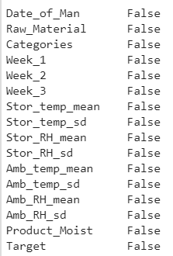
Data Pre-processing Check

Slide 7
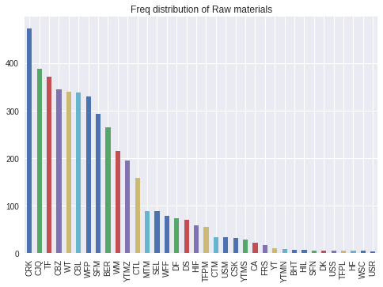
Frequency Distribution of Raw Materials

Slide 8
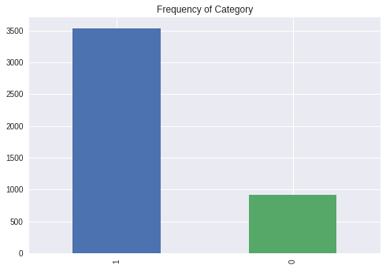
Category

Slide 9
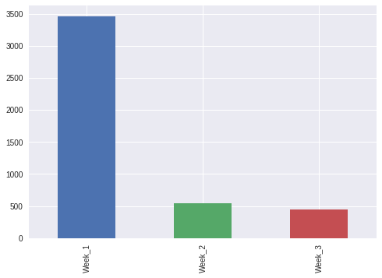
Number of Days Product in Storage Area

Slide 10
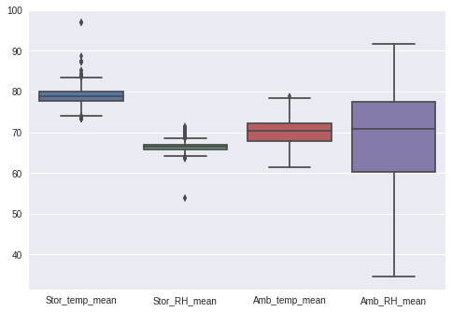
Mean and Std Dev Distribution of Storage and Ambient

Slide 11
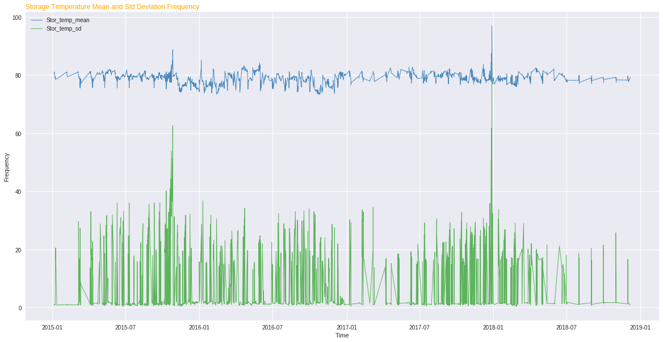
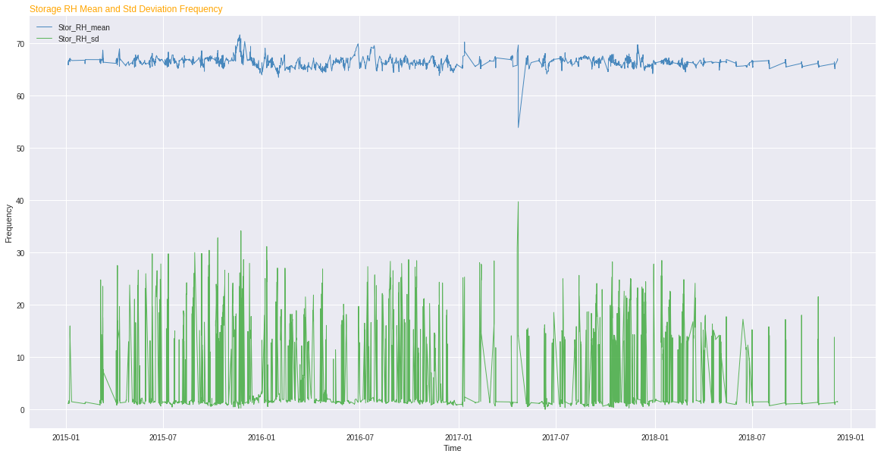
Storage Temp and RH Frequency Distribution

Slide 12
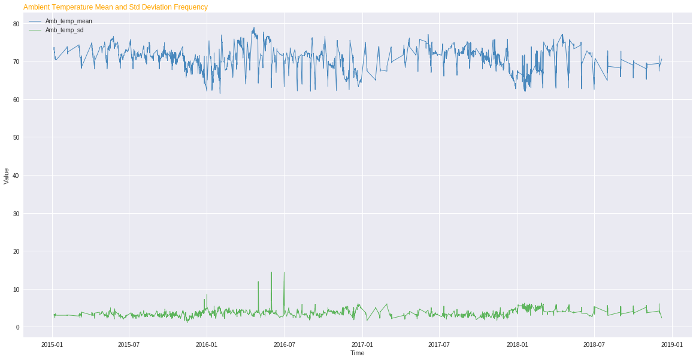
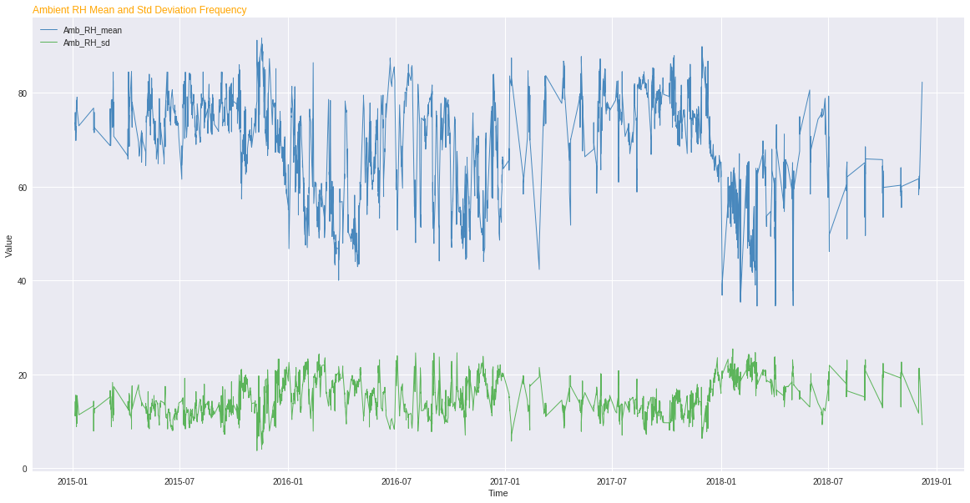
Ambient Temp and RH Distribution

Slide 13
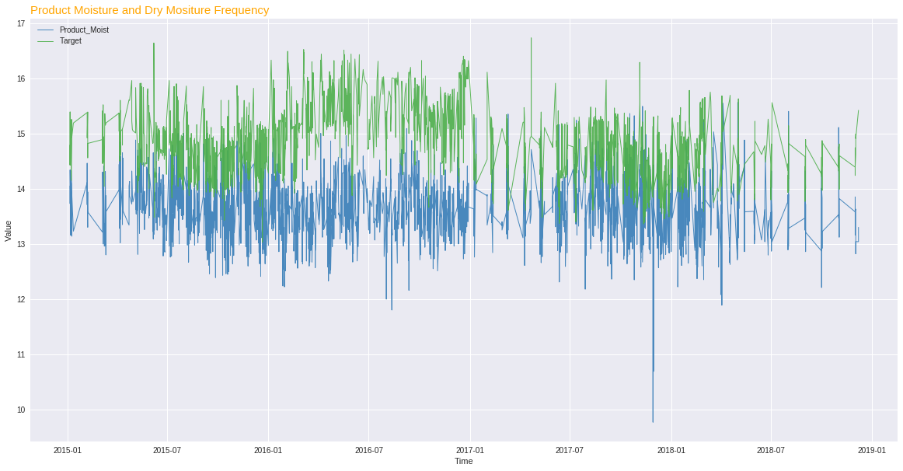
Product and Dry Moisture Frequency

Slide 14
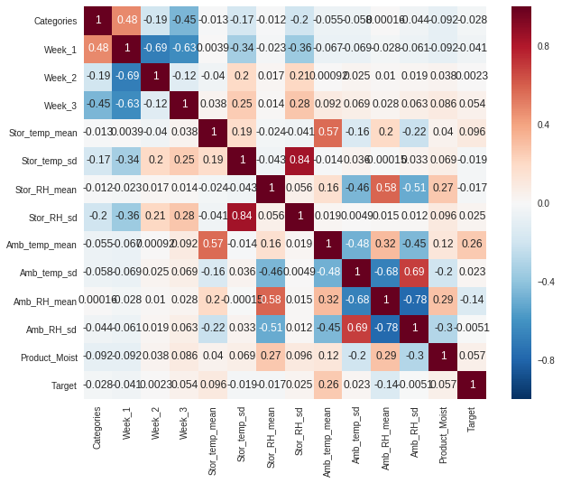
Correlation of Features

Slide 15
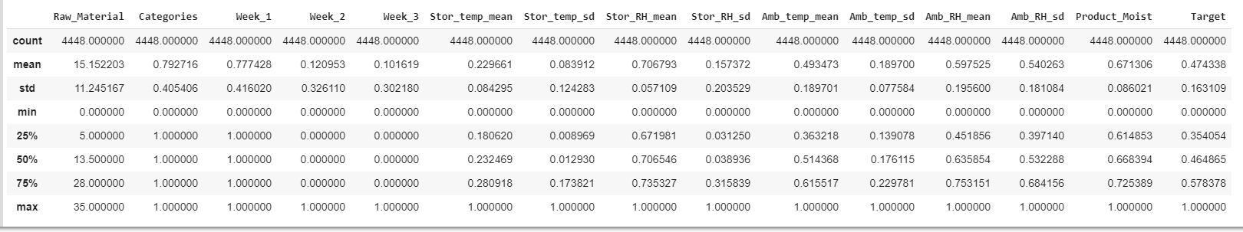
Dataset Properties

Slide 16
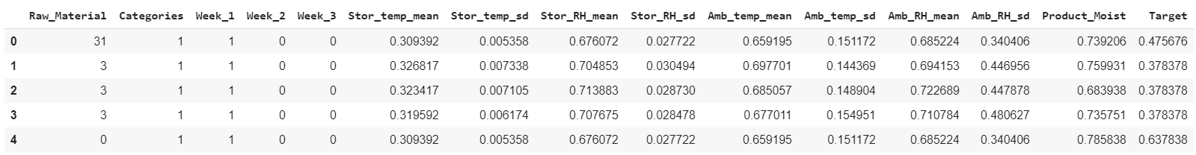
Dataframe to Fit ( Sample Head )

Slide 17
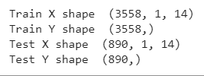
Train and Test Set ( 80 : 20 Ratio )

Slide 18
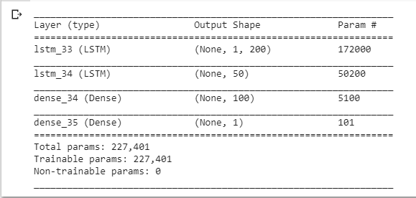
Model Architecture ( Stacked LSTM )

Slide 19
Model Properties :
Loss Function : Mean Absolute Error ( MAE )
Optimizer : Adam Optimizer
Epoch : 20
Batch Size : 10

Slide 20

Evaluation Score : ( Test Set )

Slide 21
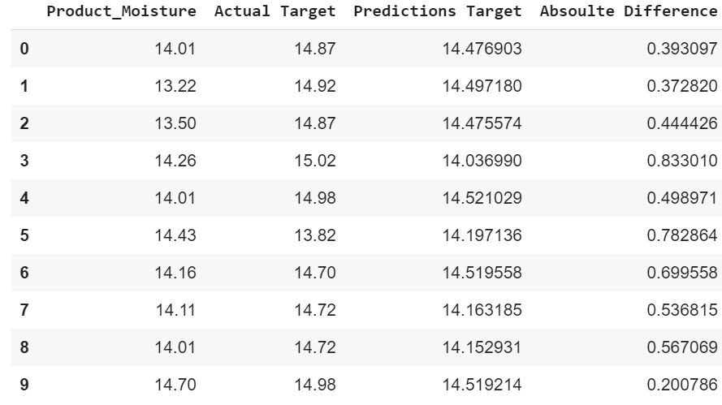
Predictions

Slide 22
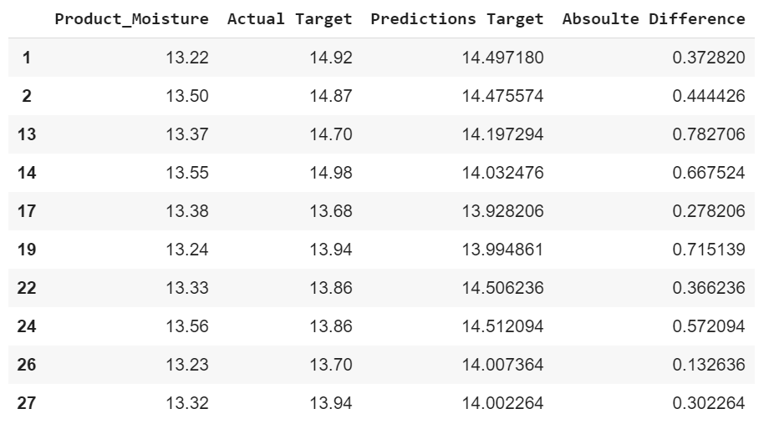
Predictions For Product Moist ( 13.2 – 13.5)

Slide 23
Future Work :
Feature Engineering
Tuning some Hyper Parameters
Minimizing difference between Actual Target and Prediction
Other methodologies
Data Training and Prediction Pipeline

Slide 24
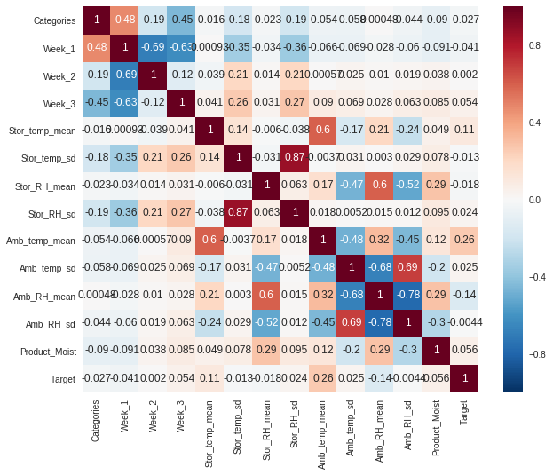
Feature importance:
Target is Highly co-related to
1. Ambient Temperature mean
2. Storage Temperature mean
Other Highly related Features:
1. Storage_RH_sd and Storage_Temp_sd
2. Ambient_Temp_mean and Storage_Temp_mean
3. Ambient_RH_sd and Ambient_temp_sd

Slide 25
Outlier treatment:
Total Data points : 4448
Total outliers found : 200
Most prominent outliers : 6
Outliers Removed : 6

Slide 26

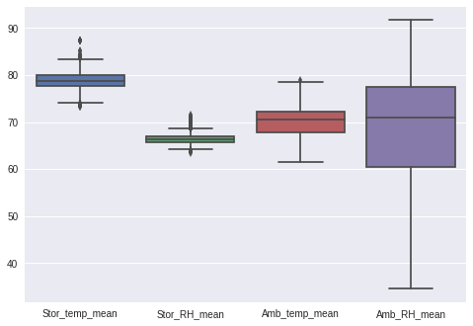
Outlier detection
BEFORE AFTER

Slide 27
Feature Engineering:
After normalisation on certain features, we reduced the correlation values of dependant variables to make it independant.
We tried PCA (Principle Component Analysis) to convert the distribution of storage and ambient temperature, RH into single vector.

Slide 28
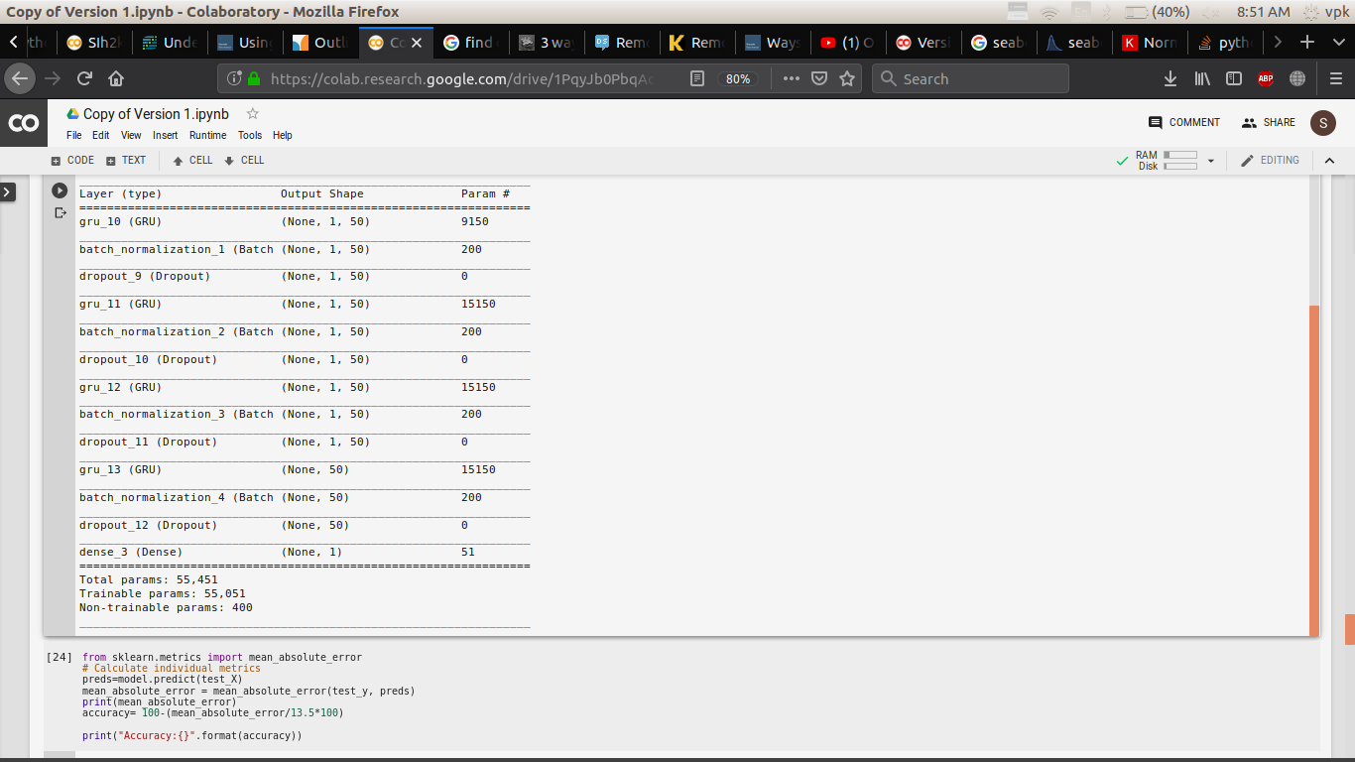
OTHER ARCHITECTURE: 1. GRU

Slide 29
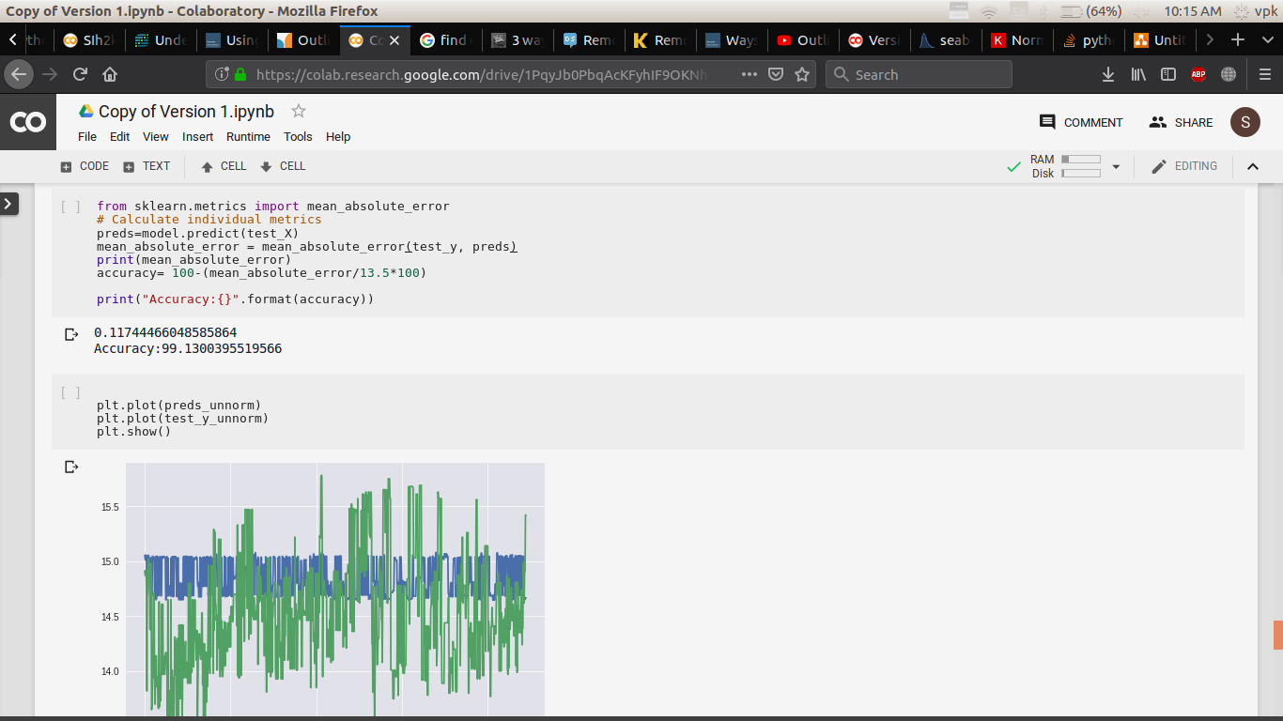
Evaluation Score:
MAE for GRU:

Slide 30
2. Sequence model of LSTM using Tensorflow ARCHITECTURE:
Input layer: (?, 14, 10)
RNN Layers: (50, Activation.elu)
LSTM layer: (1, Activation.elu )
LSTM layer: (1, Activation.elu)
Dense Layer: (10)
Loss Function: MAE
Optimizer: Adam
Learning Rate: 0.001

Slide 31
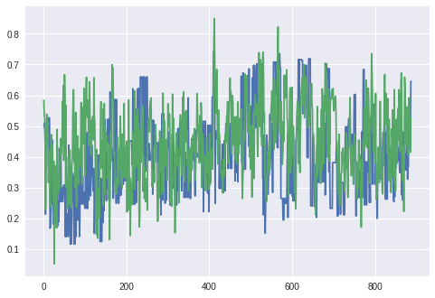
Predicted and Actual Plot

Slide 32
PREDICTION COMPARISION:
Stacked LSTM Seq LSTM MODEL

Slide 33

Evaluation Score: Consistency Check:

Slide 34
THANK YOU !

Slide 35
SUMMARY:
Mean Square Error:
LSTM -
GRU -
SEQUENCE MODEL –

Slide 36
LIMITATIONS
If Next day’s temperature varies high with current temperature ,prediction have an high absolute difference

